Slide 1
Solving problems by searching
Chapter 3
Objectives
Identify the type of agent that solve problem by searching
Problem formulation and goal formulation
Types of problem based on environment type
Discuss various techniques of search strategies
Discuss about game playing theory

Slide 2
Type of agent that solve problem by searching
  Such agent is not reflex or model based reflex agent because this agent needs to achieve some target (goal)
  It can be goal based or utility based or learning agent
  Intelligent agent knows that to achieve certain goal, the state of the environment will change sequentially and the change should be towards the goal

Slide 3
Steps to undertake during searching
Problem formulation:
  Involves:
    Abstracting the real environment configuration into state information using preferred data structure
    Describe the initial state according to the data structure
    deciding the set of all possible action
    The set of action possible on a given state at specific point in the process.
    The cost of the action at each state
  For vacuum world problem, the problem formulation involve:
    State is described as list of 3 elements where the first element describe information about block A, the second element describe information about block B and the last element describe the location of the Agent
    [dirty, dirty, A]
    Suck, moveRight, moveLeft
    Determine which of the above action are valid for a give action
    Cost can be determined in many ways

Slide 4
Steps to undertake during searching
Goal formulation: refers to the understanding of the objective of the agent based on the state description of the final environment
For example, for the vacuum world problem, the goal can be formulated as
[clean, Clean, agent at any block]

Slide 5
Solution is a sequence of world state in which the final state satisfy the goal or solution is action sequence in which the last action will result the goal state.
Each action change one state to the next state of the world
A search algorithm take a problem as input and returns a solution in the form of action or state sequence.
To achieve the goal, the action sequences must be executed accordingly
The general “formulate-search-execute” algorithm of search is given bellow:

Slide 6
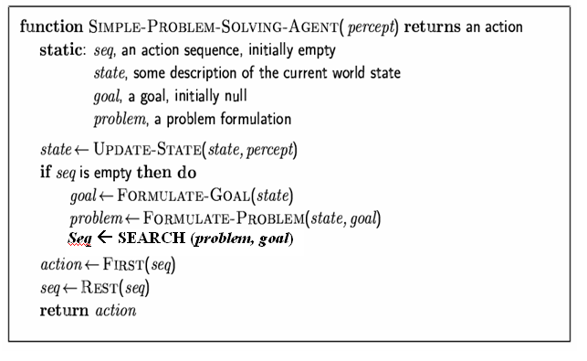
Problem-solving agents

Slide 7
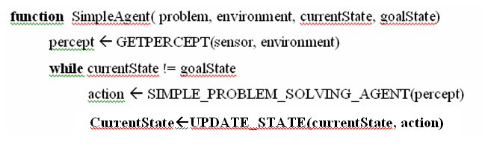
Agent Program

Slide 8
Example: Road map of Ethiopia
Axum
100
200
Mekele
Gondar
180
80
Lalibela
110
250
150
Bahr dar
Dessie
170
Debre markos
330
Dire Dawa
230
330
400
Jimma
Addis Ababa
100
430
Nazaret
370
Gambela
230
320
Nekemt
Awassa

Slide 9
Example: Road map of Ethiopia
Current position of the agent: Awassa.
Needs to arrive to: Gondar
Formulate goal:
  be in Gondar
Formulate problem:
  states: various cities
  actions: drive between cities
Find solution:
  sequence of cities, e.g., Awassa, Nazarez, Addis Ababa, Dessie, Gondar

Slide 10
Types of Problems
Four types of problems exist in the real situations:
  1. single-state problem
  The environment is Deterministic and fully observable
  Out of the possible state space, agent knows exactly which state it will be in; solution is a sequence
  2. sensor less problem (conformant problem)
  The environment is non-observable
  It is also called multi-state problem
  Agent may have no idea where it is; solution is a sequence

Slide 11
Types of Problems
3. contingency problem
  The environment is nondeterministic and/or partially observable
  It is not possible to know the effect of the agent action
  percepts provide new information about current state
  4. exploration problem
  The environment is partially observable
  It is also called unknown state space

Slide 12

Example: vacuum world
Single-state
  Starting state us known say in #5.
  What is the Solution?

Slide 13



Example: vacuum world
Single-state, start in #5.
Solution? [Right, Suck]

Slide 14
Example: vacuum world
Sensorless,
  It doesn’t know what the current state is
  So the current start is either of the following: {1,2,3,4,5,6,7,8}
  What is the Solution?

Slide 15
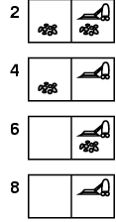
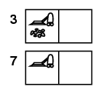
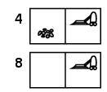

Example: vacuum world
Sensorless Solution
Right goes to {2,4,6,8}
Solution?
[Right,Suck,Left,Suck]

Slide 16
Example: vacuum world
Contingency
  Nondeterministic: Suck may
  dirty a clean carpet
  Partially observable:
  Hence we have partial information
  Let’s assume the current percept is: [L, Clean]
  i.e. start in #5 or #7
  What is the Solution?

Slide 17
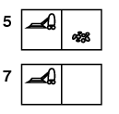



Example: vacuum world
Contingency Solution
[Right, if dirt then Suck]
Move right
suck

Slide 18
Exploration
Example 1:
Assume the agent is some where outside the blocks and wants to clean the block. So how to get into the blocks? No clear information about their location
What will be the solution?
Solution is exploration
Example 2:
The agent is at some point in the world and want to reach a city called CITY which is unknown to the agent.
The agent doesn’t have any map
What will be the solution?
  Solution is exploration

Slide 19
Some more problems that can be solved by searching
We have seen two such problems: The road map problem and the vacuum cleaner world problem
The following are some more problems
  The three mice and the three cats problem
  The three cannibal and the three missionaries problem
  The water jug problem

Slide 20
3 cat and 3 mice puzzle
Three cat and three mice come to a crocodile infested river. There is a boat on their sides that can be used by one or two “persons”. If cats outnumber the mice at any time, the cats eat the mice. How can they use the boat to cross the river so that all mice survive.
State description
  [#of cats to the left side,
  #of mice to the left side,
  boat location,
  #of cats to the right side,
  #of mice to the right side]
Initial state
  [3,3,Left,0,0]
Goal
  [0,0,Right,3,3]

Slide 21
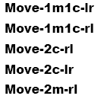
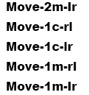
3 cat and 3 mice puzzle
Action
  A legal action is a move which moves upto two person at a time using the boat from the boat location to the other side provided that action doesn’t contradict the constraint (#cats <= #mice)
  We can represent the action as
    Move_Ncats_M_mice_lr if boat is at the left side or
    Move_Ncats_M_mice_rl if boat is at the right side.
    All the set of possible action except the constraints are:

Slide 22
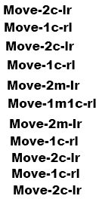
3 cat and 3 mice puzzle
Question
  Draw the state space of the problem
  Provide one possible solution

Slide 23
3 cannibal and 3 missionaries problem
Three missionaries and three cannibals come to the bank of a river they wish to cross.
There is a boat that will hold only two and any of the group is able to row.
If there are ever more missionaries than cannibals on any side of the river the cannibals will get converted.
How can they use the boat to cross the river without conversion.
State description
  [#of cannibals to the left side,
  #of missionaries to the left side,
  boat location,
  #of cannibals to the right side,
  #of missionaries to the right side]
Initial state
  [3,3,Left,0,0]
Goal
  [0,0,Right,3,3]

Slide 24
3 cannibal and 3 missionaries problem
Action
  A legal action is a move which moves up to two person at a time using the boat from the boat location to the other side provided that action doesn’t contradict the constraint (#cannibal < #missionaries)
  We can represent the action as
    Move_Ncannibal_M_missionaries_lr if boat is at the left side or
    Move_Ncannibal_M_missionaries_rl if boat is at the right side.
    All the set of possible action except the constraints are:

Slide 25
3 cannibal and 3 missionaries problem
Question
  Draw the state space of the problem
  Provide one possible solution

Slide 26
Water Jug problem
We have one 3 liter jug, one 5 liter jug and unlimited supply of water. The goal is to get exactly one liter of water in either of the jug. Either jug can be emptied, filled or poured into the other.
State description
  [Amount of water in 5 litter jug,
    Amount of water in 3 litter jug]
Initial state
  [0,0]
Goal
  [1,ANY] or [ANY, 1]

Slide 27
Water Jug problem
Action
  Fill the 3 litter jug with water (F₃)
  Fill the 5 litter jug with water(F₅)
  Empty the 5 litter jug (E₅)
  Empty the 3 litter jug (E₃)
  Pour the all 3 litter jug water onto the 5 litter jug (P_{3→5})
  Pour the all 5 litter jug water onto the 3 litter jug (P_{5→3})
  Pour the 3 litter jug water onto the 5 litter jug until the 5 litter jug filled completely. (P_part_{3→5})
  Pour the 5 litter jug water onto the 3 litter jug until the 3 litter jug filled completely. (P_part_{5→3})

Slide 28
Water Jug problem
Question
  Draw the complete state space diagram
  Find one possible solution as action and state sequence
  Initial state [0,0]
  Action State
  F₃ [3,0]
  P_{3→5} [0,3]
  F₃ [3,3]
  P_part_{3→5} [1,5]

Slide 29
Well-defined problems and solutions (single state)
A well defined problem is a problem in which
  The start state of the problem
  Its goal state
  The possible actions (operators that can be applied to make move from state to state)
  The constraints upon the possible action to avoid invalid moves (this defines legal and illegal moves)
  are known in advance

Slide 30
Well-defined problems and solutions (single state)
A problem which is not well defined is called ill-defined
  Ill-defined problem presents a dilemma in planning to get the goal
  The goal may not be precisely formulated
  Examples
    Cooking dinner
    Writing term paper
All the problem we need to consider in this course are well defined

Slide 31
Well-defined problems and solutions
A problem is defined by four items:
1. initial state e.g., "at Awassa"
2. actions or successor function S(x) = set of action–state pairs
  e.g., S(Awassa) = {<Awassa → Addis Ababa, Addis Ababa>, <Awassa → Nazareth, Nazareth>, … }
  Note: <A→B, B> indicates action is A → B and next state is B
3. goal test, can be
  explicit, e.g., x = "at Gonder"
  implicit, e.g., CheckGoal(x)

Slide 32
Well-defined problems and solutions (single state)
4. The constraints
path cost (additive)
  e.g., sum of distances, number of actions executed, etc.
  c(x,a,y) is the step cost, assumed to be ≥ 0 (the cost of applying action a being at initial state x which takes into next state y
invalid (actions that doesn’t change states)
solution is a sequence of actions leading from the initial state to a goal state or sequence of states in which the last state is the goal state

Slide 33
Selecting a state space
Real world problem can not be directly represented in the agent architecture since it is absurdly complex
  → state space must be abstracted for problem solving
(Abstract) state = set of real states
(Abstract) action = complex combination of real actions
  e.g., “Awasa → Addis Ababa" represents a complex set of possible routes, detours, rest stops, etc.
(Abstract) solution = set of real paths that are solutions in the real world
Each abstract action should be "easier" than the original problem

Slide 34

Vacuum world state space graph
states?
actions?
goal test?
path cost?

Slide 35
Vacuum world state space graph
states? Information on dirt and robot location (one of the 8 states)
actions? Left, Right, Suck
goal test? no dirt at all locations
path cost? 1 per action

Slide 36

Example: The 8-puzzle
states?
actions?
goal test?
path cost?

Slide 37
Example: The 8-puzzle
states? locations of tiles
actions? move blank left, right, up, down
goal test? = goal state (given)
path cost? 1 per move
[Note: optimal solution of n-Puzzle family is NP-hard]

Slide 38

Example: robotic assembly
states?: real-valued coordinates of robot joint angles and parts of the object to be assembled
actions?: continuous motions of robot joints
goal test?: complete assembly
path cost?: time to execute

Slide 39
Searching For Solution (Tree search algorithms)
Given state space, and network of states via actions.
The network structure is usually a graph
Tree is a network in which there is exactly one path defined from the root to any node
Given state S and valid actions being at S
  the set of next state generated by executing each action is called successor of S
Searching for solution is a simulated exploration of state space by generating successors of already-explored states

Slide 40
Implementation issue: states vs. nodes
A state is a (representation of) a physical configuration
A node is a data structure constituting part of a search tree
  It includes:
    state,
    parent node,
    action,
    depth and
    one or more costs [like path cost g(x), heuristic cost h(x), evaluation function cost f(x)]

Slide 41

Implementation issue: states vs. nodes
Example

Slide 42

Searching For Solution (Tree search algorithms)
The Successor-Fn generate all the successors state and the action that leads moves the current state into the successor state
The Expand function creates new nodes, filling in the various fields of the node using the information given by the Successor-Fn and the input parameters

Slide 43
Tree search example
Awasa
Nazarez
Addis Ababa
Gambela
Dire Dawa
Nazarez
Debre Markos
Awasa
Gambela
AA
Jima
Nekemt
Awasa
Dessie
BahrDar
AA
Lalibela
AA
Gondar
Gondar
Debre M.

Slide 44

Implementation: general tree search

Slide 45
Search strategies
A search strategy is defined by picking the order of node expansion
Strategies are evaluated along the following dimensions:
  completeness: does it always find a solution if one exists?
  time complexity: number of nodes generated
  space complexity: maximum number of nodes in memory
  optimality: does it always find a least-cost solution?
Time and space complexity are measured in terms of
  b: maximum branching factor of the search tree
  d: depth of the least-cost solution
  m: maximum depth of the state space (may be ∞)
Generally, searching strategies can be classified in to two as uninformed and informed search strategies

Slide 46
Uninformed search (blind search) strategies
Uninformed search strategies use only the information available in the problem definition
They have no information about the number of steps or the path cost from the current state to the goal
They can distinguish the goal state from other states
They are still important because there are problems with no additional information.
Six kinds of such search strategies will be discussed and each depends on the order of expansion of successor nodes.
    Breadth-first search
    Uniform-cost search
    Depth-first search
    Depth-limited search
    Iterative deepening search
    Bidirectional search

Slide 47




Breadth-first search
Expand shallowest unexpanded node
Finds the shallowest goal state
Implementation:
  Fringe (open list) is a FIFO queue, i.e., new successors go at the end

Slide 48
Properties of breadth-first search
Complete? Yes (if b is finite, which is true in most cases)
Time? 1+b+b²+b³+… +b^{d} = O(b^{d+1})
  at depth value = i , there are b^{i} nodes expanded for i ≤d
Space? O(b^{d}) (keeps every node in memory)
  a maximum of this match node will be while reaching to the goal node
  This is a major problem for real problem
Optimal? Yes (if cost = constant (k) per step)
Space is the bigger problem (more than time)

Slide 49






Depth-first search
Expand deepest unexpanded node
Implementation:
  fringe = LIFO queue, i.e., put successors at front

Slide 50
Properties of depth-first search
Complete? No: fails in infinite-depth spaces, spaces with loops
  Modify to avoid repeated states along path (see graph search)
    complete in finite spaces
Time? O(b^{m}): terrible if m is much larger than d
  but if solutions are dense, may be much faster than breadth-first
Space? O(bm), i.e., linear space!
  When the strategy move one step down the tree, it will add m nodes into the fringe and will have bm nodes at the worst case.
Optimal? No

Slide 51
Depth-limited search
We can see that the breadth search is complete which can be taken as its advantage though its space complexity is the worst
Similarly the depth first search strategy is best in terms of space complexity even if it is the worst in terms of its completeness and time complexity compared to breadth first search
Hence, we can find an algorithm that incorporate both benefits and avoid the limitation
Such algorithm is called depth limited search and its improved version is called iterative deepening search strategy.
These two strategies will be explored in the following sections

Slide 52

Depth-limited search
Depth-first search with depth limit l, will truncate all nodes having depth value greater than l from the search space and apply depth first search on the rest of the structure
It return solution if solution exist, if there is no solution
it return cutoff if l < m, failure otherwise
Recursive implementation:

Slide 53
Depth-limited search
Complete? No (fail if all solution exist at depth > l
Time? O(b^{l})
Space? O(bl)
Optimal? No

Slide 54

Iterative deepening search
Depth limit search never return a solution due to the limitation of the limit if all solution node exist at depth >l. This limitation can be avoided by applying iterative deepening search strategy
Prototype

Slide 55
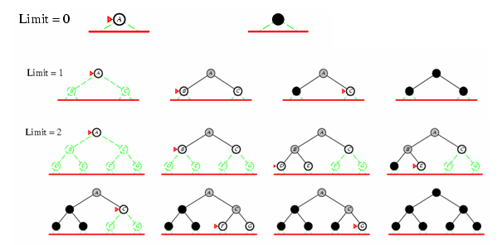
Iterative deepening search l =0

Slide 56

Iterative deepening search l =3

Slide 57
Properties of iterative deepening search
Complete? Yes
Time? (d+1)b⁰ + d b¹ + (d-1)b² + … + b^{d} = O(b^{d})
Space? O(bd)
Optimal? Yes, if step cost = 1

Slide 58
Uniform-cost search
Expand least-cost unexpanded node
Implementation:
  fringe = queue ordered by path cost
Equivalent to breadth-first if step costs all equal
Consider the problem that moves from node S to G
S
A, 1
B, 5
C, 15
A
1
10
S
S
5
B
5
G
A, 1
B, 5
C, 15
15
C
5
G, 11
S
A, 1
B, 5
C, 15
G, 11
G, 10

Slide 59
Uniform-cost search
It finds the cheapest solution if the cost of a path never decrease as we go along the path
i.e. g(sucessor(n)) ≥ g(n) for every node n.
Complete? Yes
Time? # of nodes with g ≤ cost of optimal solution
  let ε be the minimum step cost in the search tree, C* is the total cost of the optimal solution and branching factor b.
  Now you can ask, In the worst case, what will be the number of nodes that exist all of which has step cost = ε, branching factor b and path cost ≤ C*. The resulting tree will have depth value floor(C*/ ε)
  Hence the total node will be b^{ceilling(C*/ ε)} . Therefore, time complexity becomes O(b^{ceiling(C*/ ε)})
Space? # of nodes with g ≤ cost of optimal solution, O(b^{ceiling(C*/ ε)})
Optimal? Yes – nodes expanded in increasing order of g(n)

Slide 60
Bidirectional search
Simultaneously search forward from the initial state and backward from the goal state and terminate when the two search meet in the middle
Reconstruct the solution by backward tracking towards the root and forward tracking towards the goal from the point of intersection
These algorithm is efficient if there any very limited one or two nodes with solution state in the search space

Slide 61


Repeated states
Summary of algorithms
Failure to detect repeated states can turn a linear problem into an exponential one!

Slide 62

Graph search

Slide 63
Informed search algorithms
Informed search is a strategy that uses information about the cost that may incur to achieve the goal state from the current state.
The information may not be accurate. But it will help the agent to make better decision
This information is called heuristic information

Slide 64
There several algorithms that belongs to this group. Some of these are:
    Best-first search
      Greedy best-first search
      A* search
    Memory Bound Best First search
      Iterative deepening A* (IDA*) search
      Simplified Memory –Bounded A* (SMA*) search
    Iterative improvement algorithm (Local search algorithms)
      Hill-climbing search
      Simulated annealing search
    Genetic algorithms

Slide 65
Best-first search
Idea: use an evaluation function f(n) for each node
  Estimate of "desirability“ using heuristic and path cost
  Expand most desirable unexpanded node
The information gives a clue about which node to be expanded first
This will be done during queuing
The best node according to the evaluation function may not be best
Implementation:
Order the nodes in fringe in decreasing order of desirability (increasing order of cost evaluation function)

Slide 66
Ethiopia Map with step costs in km
Straight Line distance to Gondar
Aksum
Gondar 0
Aksum 100
Mekele 150
Lalibela 110
Desseie 210
Bahrdar 90
Debre Markos 170
Addis Ababa 321
Jima 300
Diredawa 350
Nazarez 340
Gambela 410
Awasa 500
Nekemt 420
100
200
Mekele
Gondar
180
80
Lalibela
110
250
150
Bahr dar
Dessie
170
Debre markos
330
Dire Dawa
230
330
400
Jima
Addis Ababa
100
430
Nazarez
370
Gambela
230
320
Nekemt
Awasa

Slide 67
Greedy best-first search
Evaluation function f(n) = h(n) (heuristic)
= estimate of cost from n to goal
That means the agent prefers to choose the action which is assumed to be best after every action
e.g., h_{SLD}(n) = straight-line distance from n to Gondar
Greedy best-first search expands the node that appears to be closest to goal (It tries to minimizes the estimated cost to reach the goal)
Example One
Greedy best-first search example
Show the flow to move from Awasa to Gondar using the given road map graph

Slide 68
Example Two
Greedy best-first search example
Heuristic
R → G -------------- 100
A → G -------------- 60
B → G -------------- 80
C → G -------------- 70
D → G -------------- 65
E → G -------------- 40
F → G -------------- 45
H → G ---------------10
I → G ---------------- 20
J → G ---------------- 8
G₁,G₂,G₃ → G ------------ 0
Given the following tree structure, show the content of the open list and closed list generated by Greedy best first search algorithm
R
A
B
C
D
E
F
G1
H
G2
I
G3
J

Slide 69
Properties of greedy best-first search
Complete? Yes if repetition is controlled otherwise it can can get stuck in loops
Time? O(b^{m}), but a good heuristic can give dramatic improvement
Space? O(b^{m}), keeps all nodes in memory
Optimal? No

Slide 70
A* search
Idea: avoid expanding paths that are already expensive
Evaluation function f(n) = g(n) + h(n) where
g(n) = cost so far to reach n
h(n) = estimated cost from n to goal
f(n) = estimated total cost of path through n to goal
It tries to minimizes the total path cost to reach into the goal at every node N.
Example one
Indicate the flow of search to move from Awasa to Gondar using A*

Slide 71
Example Two
Heuristic
R → G -------------- 100
A → G -------------- 60
B → G -------------- 80
C → G -------------- 70
D → G -------------- 65
E → G -------------- 40
F → G -------------- 45
H → G ---------------10
I → G ---------------- 20
J → G ---------------- 8
G₁,G₂,G₃ → G ------------ 0
Given the following tree structure, show the content of the open list and closed list generated by A* best first search algorithm
R
35
70
40
A
B
C
25
10
18
62
21
45
D
E
F
G1
H
G2
15
20
5
I
G3
J

Slide 72
Admissible heuristics
A heuristic h(n) is admissible if for every node n,
h(n) ≤ h*(n), where h*(n) is the true cost to reach the goal state from n.
An admissible heuristic never overestimates the cost to reach the goal, i.e., it is optimistic
Example: h_{SLD}(n) (never overestimates the actual road distance)
Theorem: If h(n) is admissible, A* using TREE-SEARCH is optimal

Slide 73
Find Admissible heuristics for the 8-puzzle?
h₁(n) = number of misplaced tiles
h₂(n) = total Manhattan distance (i.e., no. of squares from desired location of each tile). This is also called city cap distance
h₁(S) = ?
h₂(S) = ?

Slide 74
Admissible heuristics
E.g., for the 8-puzzle:
h₁(n) = number of misplaced tiles
h₂(n) = total Manhattan distance
(i.e., no. of squares from desired location of each tile)
h₁(S) = ? 8
h₂(S) = ? 3+1+2+2+2+3+3+2 = 18
Dominance
  If h₂(n) ≥ h₁(n) for all n (both admissible)
  then h₂ dominates h₁
  h₂ is better for search

Slide 75
Properties of A*
Complete? Yes (unless there are infinitely many nodes with f ≤ f(G) )
Optimal? Yes (provided that the heuristic is admissible)
Time?
  In the best case (if the heuristic is the same as the actual cost), it is equivalent to the depth of the solution node (i.e. it is linear). O(d)
  In the worst case, it is equivalent to the number of nodes which has f-value ≤ f-value of the solution node O(b^{ceiling(C*/ ε)}) where C* is the f value of the solution node
  This shows, A* search is computationally efficient compaired to Greedy best first search strategy

Slide 76
Properties of A*
Space? Keeps all nodes in memory (exponential)
  i.e. O(b^{m})
  This is again a limitation in the same way as we saw while discussing Greedy, Breadth and Depth first search
  Hence, it is advisable to have modified version of such algorithm in which the modification minimizes the space complexity
  There are two such modifications
      Iterative deepening A* (IDA*) search
      Simplified Memory Bound A* (SMA*) search

Slide 77
Iterative Deepening A* (IDA*) search
Iterative deepening is a useful technique for reducing memory requirements.
The same trick as iterative deepening depth first search is applied to A* for the same purpose.
This time the limiting factor will be f-value rather than depth value.
At first step, the root f-value will be used as a threshold and all the nodes following the root will be visited until:
  The solution found
  The node f-value exceeds the root

Slide 78
Iterative Deepening A* (IDA*) search
If solution doesn’t exist in this limit, the f-value threshold will be modified as the minimum value of a visited node whose f-value exceeds the previous threshold
This process repeat until solution found or failure (due to absence of extra node with f-value that exceed the last threshold
the algorithm is stated in the next slide

Slide 79
Iterative Deepening A* (IDA*) search
Function IDA*(problem) returns a solution sequence or failure
local variable: f-limit, the current f-COST limit
root, the root node
root← MAKE_NODE(INITIAL_STATE[problem])
f-limit←f-COST(root)
loop do
solution, f-limit ←F_CONTOUR_SEARCH(root, f-limit)
if solution is NOT NULL return solution
if f-limit = INFINITY return failure
End

Slide 80
Iterative Deepening A* (IDA*) search
Function F_CONTOUR_SEARCH(node, f-limit) returns solution sequence and a new f-COST limit
local variables:
next-f the f_COST limit for the next contour, initially INFINITY
if f_COST[node] > f-limit return null, f-COST[node]
if GOAL_TEST[problem](STATE[node]) return SOLUTION(node), f-limit
for each node s in SUCCESSOR(node) do
solution, new-f ← F_CONTOUR_SEARCH(node, f-limit)
if solution is NOT NULL return solution, f-lmit
next-f ←MIN(next-f, new-f)
END
return null, next-f

Slide 81
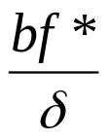

Iterative Deepening A* (IDA*) search
IDA* is complete and optimal with the same caveat as A*
Space and time complexity
Where b is the branching factor, f* is the cost of the optimal solution and δ is the smallest step cost
IDA* has difficulty in more complex domains especially when the next f-value may only add one node than the nodes expanded in the previous iteration
In this case, if A* expand N nodes, the IDA* in the worst case will expand 1 + 2 + …+N = O(N²)

Slide 82
Simplified Memory Bounded A* (SMA*) search
SMA* algorithm can make use of all the available memory to carry out the search.
SMA* has the following property
  It will utilize whatever memory is made available to it
  It avoids repeated states as far as its memory is sufficient to store the shallowest solution path
  It is optimal if enough memory is available to store the shallowest optimal solution path.
  Otherwise, it returns the best solution that can be reached with available memory
  When enough memory is available for the entire search tree, the search is optimally efficient
The next slide shows algorithm

Slide 83
Simplified Memory Bounded A* (SMA*) search
Functon SMA*(problem) return solution/failure
  Local variable: Queue, a queue of node ordered by f-value initially empty
  Queue←MAKE-QUEUE(MAKE-MODE(INITIAL-STATE[problem]))
  Loop do
  if Queue is empty return failure
  n← deepest least f-cost node in queue
  if GOAL-TEST(n) return success
  s←NEXT-SUCESSOR(n)
  if s is not a goal and is at maximum depth then (not goal and is a leaf)
  f(s) ← ∞
  else
  f(s) ← MAX(f(n), f(s))
  if all n’s successors have been generated then
  update n’s f-cost and those of its ancestors if necessary
  if SCESSORS(n) are all in memory then remove n from Queue
  if memory is full then
  delete the shallowest, highest f-cost node in Queue
  remove it from its parent’s successor list
  insert its parent on Queue if necessary
  insert s on Queue
  end

Slide 84

Iterative Improvement Algorithm (Local search algorithms)
In many optimization problems, the path to the goal is irrelevant; the goal state itself is the solution
State space = set of "complete" configurations
Find configuration satisfying constraints, e.g., n-queens
In such cases, we can use local search algorithms
keep a single "current" state, try to improve it
Example: n-queens
Put n queens on an n × n board with no two queens on the same row, column, or diagonal

Slide 85
Iterative Improvement Algorithm (Local search algorithms)
There are two types of Iterative Improvement algorithms
  Hill climbing if the evaluation function is quality
    also called Gradient Descent if the evaluation function is a cost rather than a quality
  Simulated Annealing

Slide 86

Hill-climbing search
Tries to make changes that improve the current state cost
The algorithm is given bellow
It continually move in the direction of increasing value
The node data structure maintain only records of state and evaluation cost

Slide 87

Hill-climbing (Gradient Descent) search
Tries to make changes that improve the current state cost
Problem:
Depending on initial state, can get stuck in local maxima
Plateaux (after some progress the algorithm will make a random walk)
Ridges (a place where two sloppy sides meet). In this case the search may oscillate from side to side

Slide 88


Hill-climbing search: 8-queens problem
h = number of pairs of queens that are attacking each other, either directly or indirectly
h = 17 for the above state
A local minimum with h = 1
Improvement techniques
  Random restart hill climbing for N iteration by saving the best state so far

Slide 89

Simulated Annealing
Idea: escape local maxima by allowing some "bad" moves but gradually decrease their frequency

Slide 90
Properties of simulated annealing search
One can prove: If T decreases slowly enough, then simulated annealing search will find a global optimum with probability approaching 1
Widely used in VLSI layout, airline scheduling, etc
Local beam search
Keep track of k states rather than just one
Start with k randomly generated states
At each iteration, all the successors of all k states are generated
If any one is a goal state, stop; else select the k best successors from the complete list and repeat.

Slide 91
Genetic algorithms
Genetic Algorithms were invented to mimic some of the processes observed in natural evolution.
Many people, biologists included, are astonished that life at the level of complexity that we observe could have evolved in the relatively short time suggested by the fossil record.
The idea with GA is to use this power of evolution to solve optimization problems.
The father of the original Genetic Algorithm was John Holland who invented it in the early 1970's.
Genetic Algorithms (GAs) are adaptive heuristic search algorithm based on the evolutionary ideas of natural selection and genetics.

Slide 92
Genetic algorithms
The basic techniques of the GAs follow the principles first laid down by Charles Darwin of "survival of the fittest."
In nature, competition among individuals results in the fittest individuals dominating over the weaker ones.
GA is better than conventional AI in that it is more robust.
Unlike older AI systems, they do not break easily even if the inputs changed slightly, or in the presence of reasonable noise.
Also, in searching a large state-space, multi-modal state-space, or n-dimensional surface, a genetic algorithm may offer significant benefits over more typical search of optimization techniques like linear programming, heuristic, depth-first, breath-first, and praxis.

Slide 93
Genetic algorithms
GAs simulate the survival of the fittest among individuals over consecutive generation for solving a problem.
Each generation consists of a population of character strings that are analogous to the chromosome that we see in our DNA.
Each individual represents a point in a search space and a possible solution.
The individuals in the population are then made to go through a process of evolution.
GAs are based on an analogy with the genetic structure and behavior of chromosomes within a population of individuals using the following foundations:

Slide 94
Genetic algorithms
  Basic GA foundations
  Individuals in a population compete for resources and mates.
  Those individuals most successful in each 'competition' will produce more offspring than those individuals that perform poorly.
  Genes from `good' individuals propagate throughout the population so that two good parents will sometimes produce offspring that are better than either parent.
  Thus each successive generation will become more suited to their environment.

Slide 95
Genetic algorithms Search Space
A population of individuals are maintained within search space for a GA, each representing a possible solution to a given problem.
Each individual is coded as a finite length vector of components, or variables, in terms of some alphabet, usually binary alphabet {0,1}.
To continue the genetic analogy these individuals are likened to chromosomes and the variables are analogous to genes.
Thus a chromosome (solution) is composed of several genes (variables).
A fitness score is assigned to each solution representing the abilities of an individual to `compete'.
The individual with the optimal (or generally near optimal) fitness score is sought.

Slide 96
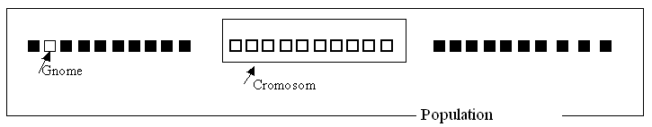
Genetic algorithms Search Space
The GA aims to use selective `breeding' of the solutions to produce `offspring' better than the parents by combining information from the chromosomes.

Slide 97
Genetic algorithms Search Space
The GA maintains a population of n chromosomes (solutions) with associated fitness values.
Parents are selected to mate, on the basis of their fitness, producing offspring via a reproductive plan.
Highly fit solutions are given more opportunities to reproduce, so that offspring inherit characteristics from each parent.
Since the population is kept at a static size, individuals in the population die and are replaced by the new solutions, eventually creating a new generation once all mating opportunities in the old population have been exhausted.
In this way it is hoped that over successive generations better solutions will thrive while the least fit solutions die out.
Eventually, once the population has converged and is not producing offspring noticeably different from those in previous generations, the algorithm itself is said to have converged to a set of solutions to the problem at hand.

Slide 98
Genetic algorithms Implementation Details
After an initial population is randomly generated, the algorithm evolves the through three operators:
    selection which equates to survival of the fittest;
    crossover which represents mating between individuals;
    mutation which introduces random modifications.
1. Selection Operator
    key idea: give preference to better individuals, allowing them to pass on their genes to the next generation.
    The goodness of each individual depends on its fitness.
    Fitness may be determined by an objective function or by a subjective judgment.
2. Crossover Operator
    Prime distinguished factor of GA from other optimization techniques
    Two individuals are chosen from the population using the selection operator

Slide 99
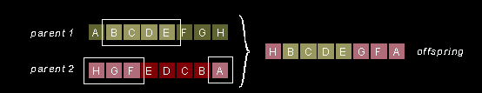
Genetic algorithms Implementation Details
2. Crossover Operator (cont ….)
    A crossover site along the bit strings is randomly chosen
    The values of the two strings are exchanged up to this point
    If S1=000000 and s2=111111 and the crossover point is 2 then S1'=110000 and s2'=001111
    The two new offspring created from this mating are put into the next generation of the population
    By recombining portions of good individuals, this process is likely to create even better individuals

Slide 100

Genetic algorithms Implementation Details
3. Mutation Operator
    With some low probability, a portion of the new individuals will have some of their bits flipped.
    Its purpose is to maintain diversity within the population and inhibit premature convergence.
    Mutation alone induces a random walk through the search space
    Mutation and selection (without crossover) create a parallel, noise-tolerant, hill-climbing algorithms
Example:

Slide 101

Genetic algorithms Implementation Details
3. Mutation Operator
Fitness function: number of non-attacking pairs of queens (min = 0, max = 8 × 7/2 = 28)
24/(24+23+20+11) = 31%; 23/(24+23+20+11) = 29% etc

Slide 102
Game playing (Adversarial Search)
Outlines
  How to make optimal decisions in two player game
  MinMax algorithm
  α-β pruning algorithm
In Game theory there are always at least two agents that participate.
There may be different groups that participate in game where each of them go for win or maximize the objective
In this topic, we focus on only two player game:
  Player1 wants to maximize his objective function at the end of the game
  Player2 (opponent): wants to minimize player1 objective function

Slide 103
Game playing (Adversarial Search)
Opponent always introduce uncertainty because one never knows what action the opponent may choose
This unpredictable nature of game playing makes it different from search problem.
In most cases, game playing has very large branching factor which will have a direct impact on the implementation time and space complexity
Example: Tic-Tac-Toe

Slide 104

Game tree (2-player, deterministic, turns)

Slide 105
Components
  Initial state (environment + whose turn to move)
  Operators (defines legal move to the agent)
  Terminal test
  Utility function (payoff function)
  Minimax Algorithm
Perfect play for deterministic games
Idea: choose move to position with highest Minimax value
= best achievable payoff against best play
E.g., 2-ply game:
The algorithm consists of five steps
Generate the whole tree
Apply the utility function to each terminal state to get its value
Determine the utility of upper state using the lower states
Continue upward until the root
Max should choose the best play

Slide 106
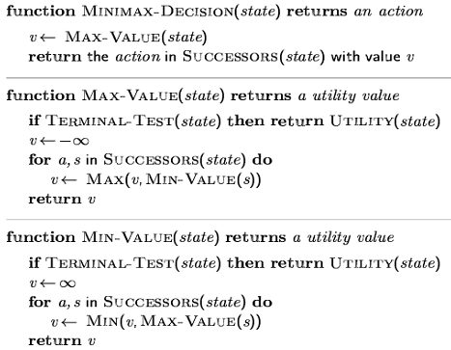

Minimax algorithm

Slide 107
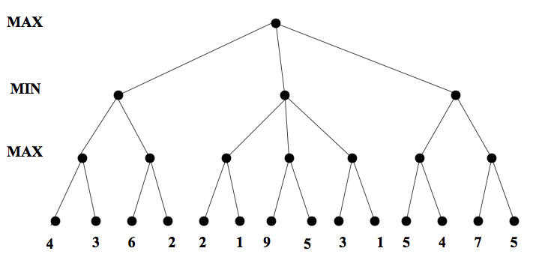
Minimax. Example

Slide 108
Properties of minimax
Complete? Yes (if tree is finite)
Optimal? Yes (against an optimal opponent)
Time complexity? O(b^{m})
Space complexity? O(bm) (depth-first exploration)

Slide 109
α-β pruning
The MiniMax algorithm works well in almost any game problems.
But its time complexity is very very discouraging to problems of relatively larger depth and branching factor.
For example, in chase game the branching factor is around 35 and if the game need around 5 move each (total 10 moves) then the time complexity becomes 35¹⁰.
If we assume our computer process 100000 per second, it will take several years.
Therefore, we should think a better algorithm that optimizes the search
α-β Pruning is one specific pruning technique used in game theory
By pruning we mean removing paths which will not take the agent to a better solution.

Slide 110
α-β pruning
Alpha (α ) minimal score that player MAX is guaranteed to attain.
Beta (β ) maximum score that player MAX can hope to obtain against a sensible opponent.

Slide 111
α-β pruning algorithm description
Case one: pruning via calling MIN function
Consider M is a node for MAX and it has guaranteed α using all the paths to the left of P1 and assume the utility of N_{i} for i < K is greater than α. However utility of N_{k} < α. This shows if MAX choose to apply action P1, then MIN will choose P2 that minimizes MAX utility which MAX don’t want at all. Therefore the moment this situation happen, no need to investigate all the sub trees with roots N_{i} where k < i <= m
MAX Node
M
α
P1
MIN Nodes
P2
MAX Nodes
N₁
N_{k}
N_{m}

Slide 112
α-β pruning algorithm description
Case two: pruning via calling MAX function
Consider M is a node for MIN and it knows that MAX could obtain β using all the paths to the left of P1 and assume the utility of N_{i} for i< K is less than β. However utility of N_{k} > β. This shows if MIN choose to apply action P1, then MAX will choose P2 that maximizes MAX utility which MIN don’t want at all. Therefore the moment this situation happen, no need to investigate all the sub trees with roots N_{i} where k < i <= m
MIN Node
M
β
P1
MAX Nodes
P2
MIN Nodes
N₁
N_{k}
N_{m}

Slide 113
Example:
Show the utility of each of nodes and prune unnecessary nodes using α-β pruning algorithm for the following state space tree
3
4
4
7
6
9
25
30
12
-10
0

Slide 114

The α-β algorithm

Slide 115

The α-β algorithm

Slide 116
= ∞
α= -∞
3
4
4
= ∞
α= 3
7
6
9
25
30
12
-10
0
= 3
α= ∞
3
4
4
7
6
9
25
30
12
-10
0

Slide 117
= ∞
α= 3
= 3
α= ∞
= ∞
α= 3
= ∞
α= 7
3
4
4
= ∞
α= 3
= 3
α= ∞
7
6
9
25
30
12
-10
0
= 7
α= 3
3
4
4
7
6
9
25
30
12
-10
0

Slide 118
= ∞
α= 3
= 3
α= ∞
= 7
α= 3
3
4
4
= ∞
α= 7
7
6
9
25
30
12
-10
0
= 3
α= ∞
= 7
α= 3
V = 9
= 7
α= 3
3
4
4
7
6
9
25
30
12
-10
0

Slide 119
= ∞
α= 7
= ∞
α= 7
V = 4
= 3
α= ∞
= 7
α= 3
3
4
4
7
6
9
25
30
12
-10
0

Slide 120

Properties of α-β
Pruning does not affect final result
Good move ordering improves effectiveness of pruning
With "perfect ordering," time complexity = O(b^{m/2})
  → doubles depth of search
Why is it called α-β?
  α is the value of the best (i.e., highest-value) choice found so far at any choice point along the path for max
  If v is worse than α, max will avoid it
    → prune that branch
  Define β similarly for min

